Slide 1
UI/UX Principles CET219
Lab 2: This session will equip you with the skills to create organized, consistent, and efficient designs in Figma.

Slide 2
Table of Contents
Design Interface Explained
Adding Colors and Texts Inside the Library
Explanation of Autolayout
Component Explanation

Slide 3
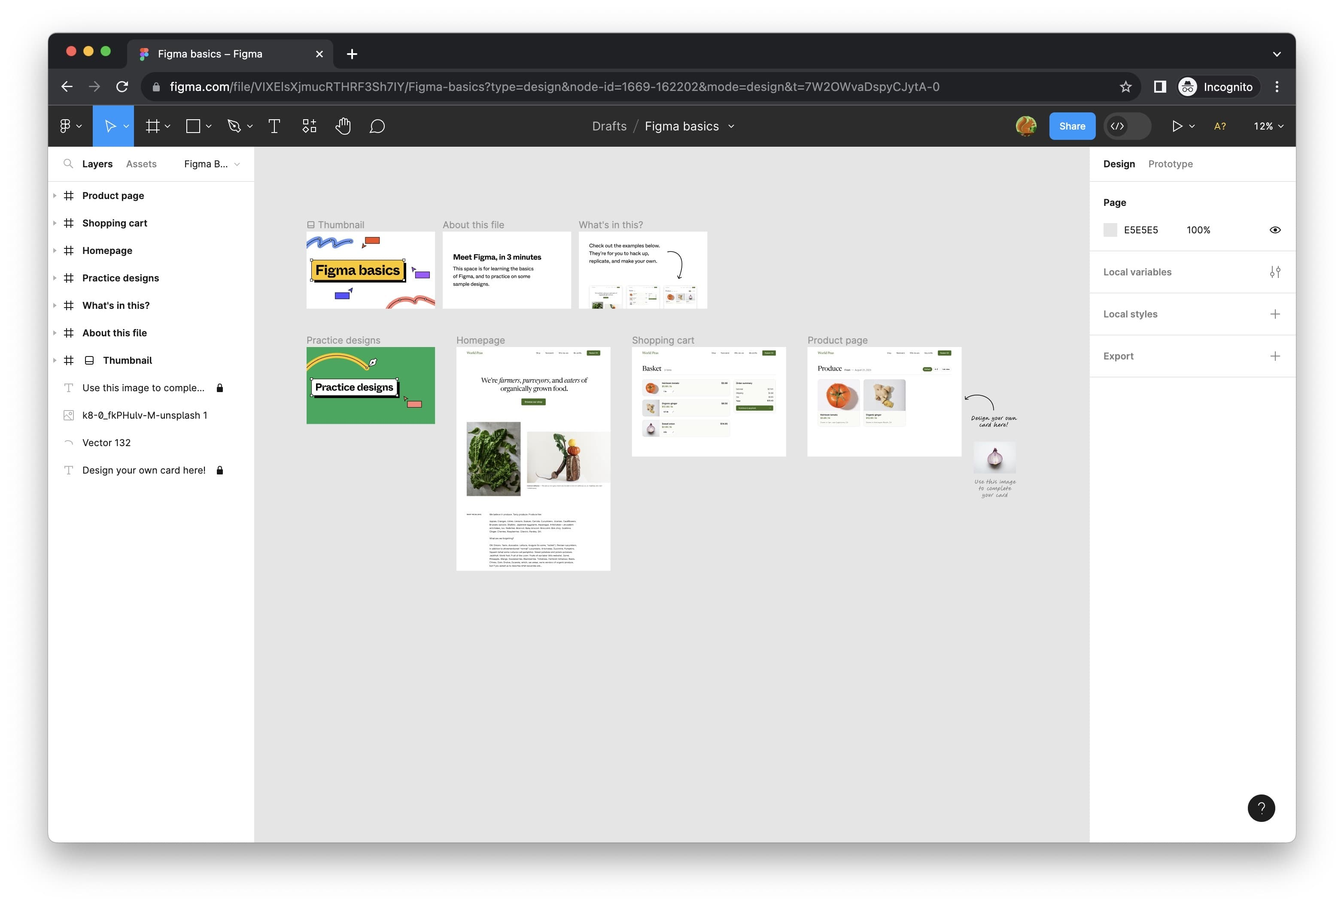
Design Interface Explained
1. Set up your Figma account

Slide 4
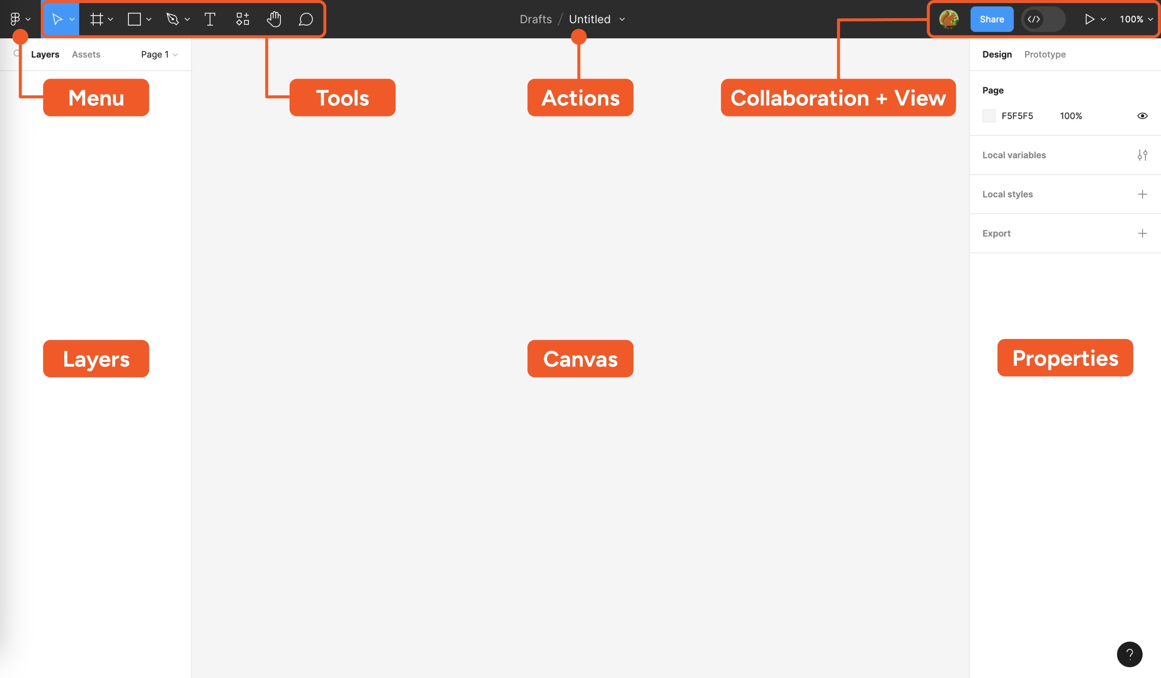
Design Interface Explained
2. Take a look around the Figma interface

Slide 5
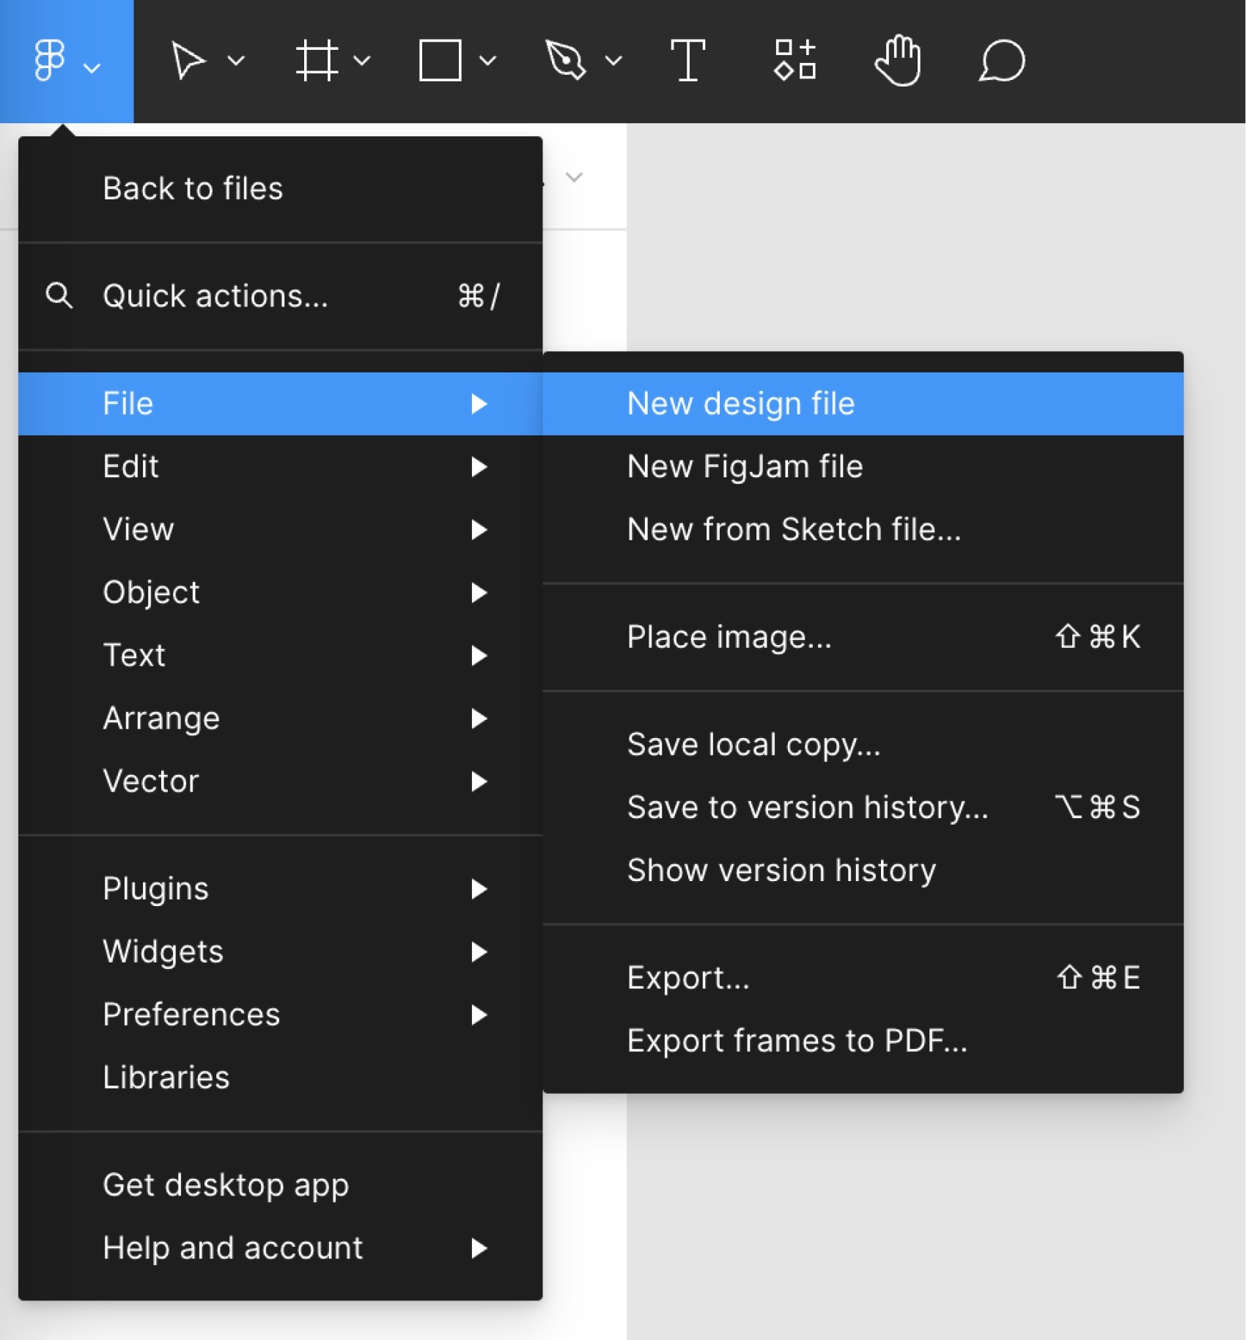
Design Interface Explained
3. Start a new design file

Slide 6
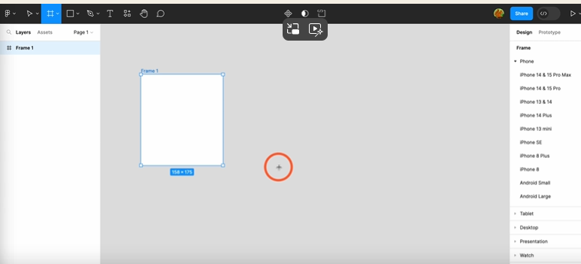
Design Interface Explained
4. Create a Frame

Slide 7
Adding Colors and Texts Inside the Library
Styles allow you to define a set of properties of an object, that can be reused across your designs.
Create styles for:
Text: font family, size, line height, spacing
Text styles can be applied to an entire layer or portions of text. This is perfect for defining the styles of headers, body text, and text within paragraphs—such as linked text.
Because text styles can’t be created for text alignment, you must set alignment for each block individually.
Colors: fill, stroke, image, gradient
When creating a style for a gradient, both the colors used and the gradient direction, or angle, will be saved to the style.

Slide 8
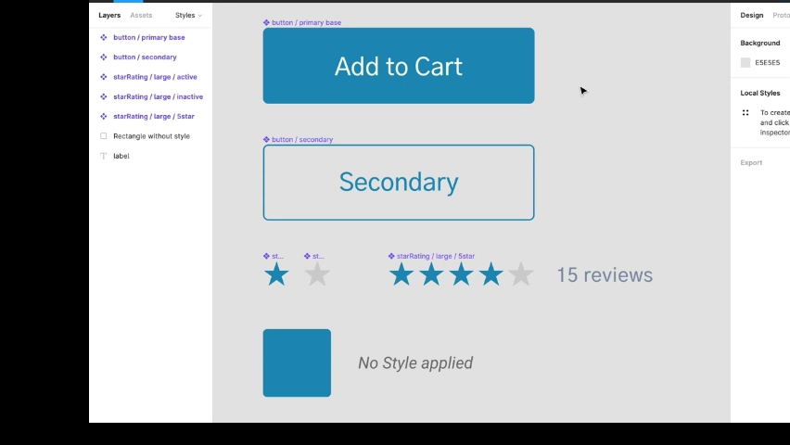
Adding Colors and Texts Inside the Library

Slide 9
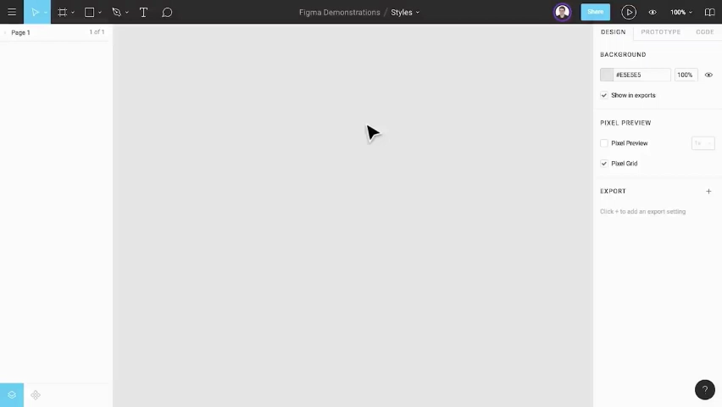
Adding Colors and Texts Inside the Library

Slide 10
Explanation of Autolayout
Auto Layout in Figma is a powerful feature that helps you create responsive and flexible designs. Here's a breakdown of how to use it and its key properties:
Auto Layout Properties
Direction: Choose whether the items should be laid out horizontally or vertically
Spacing: Adjust the spacing between items. This can be done by setting fixed spacing or using padding to control the space around items
Alignment: Align items within the auto layout frame. You can align items to the top, bottom, left, right, or center
Resizing: Set how items should resize within the auto layout frame. Options include fixed size, fill container, hug contents, and more

Slide 11
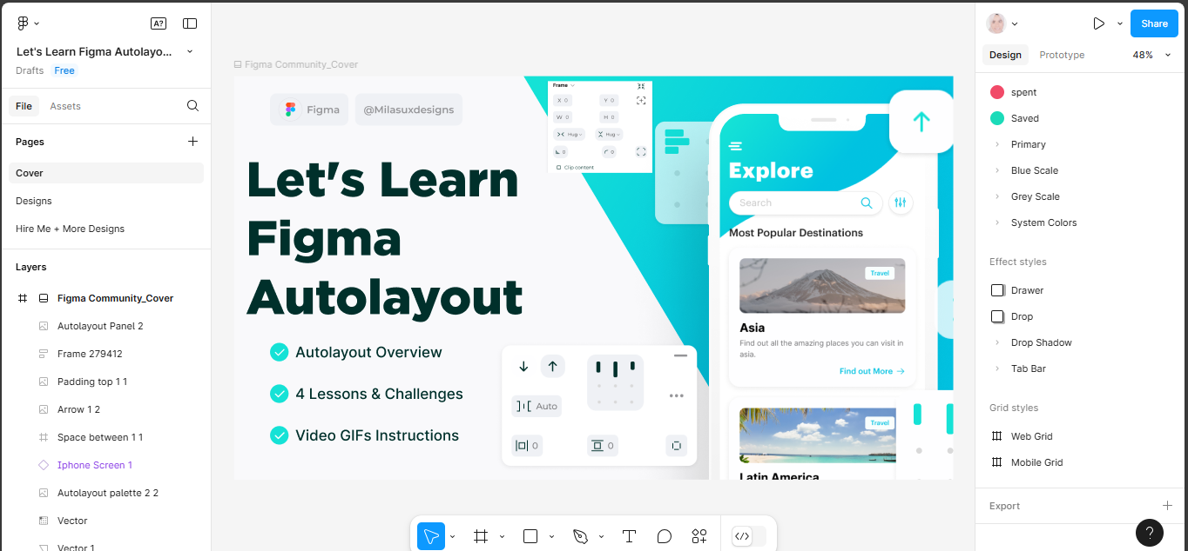
Explanation of Autolayout

Slide 12
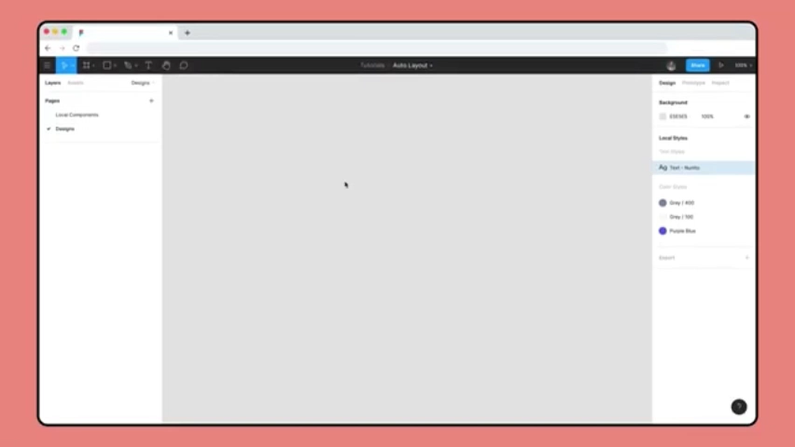
Autolayout Practical Uses

Slide 13
Component Explanation
Component properties are the changeable aspects of a component. They allow you to communicate which parts of a component can be changed, such as:
Which layers in a component have the option to be hidden or shown
Whether an instance can be swapped and set preferred instances to swap to
Which text strings can be changed
Component properties are created and applied to main components and component sets to define parts of a design system and to make design systems easier to use.

Slide 14
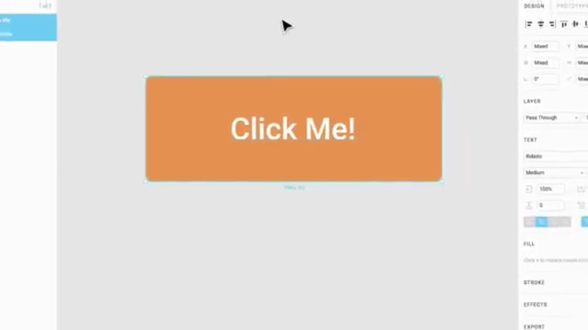
Component Practical Uses

Slide 15


